Slide 2
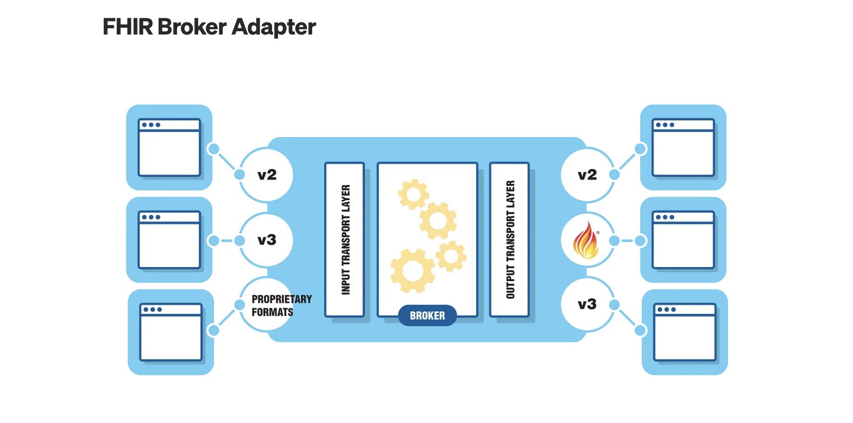

Slide 3
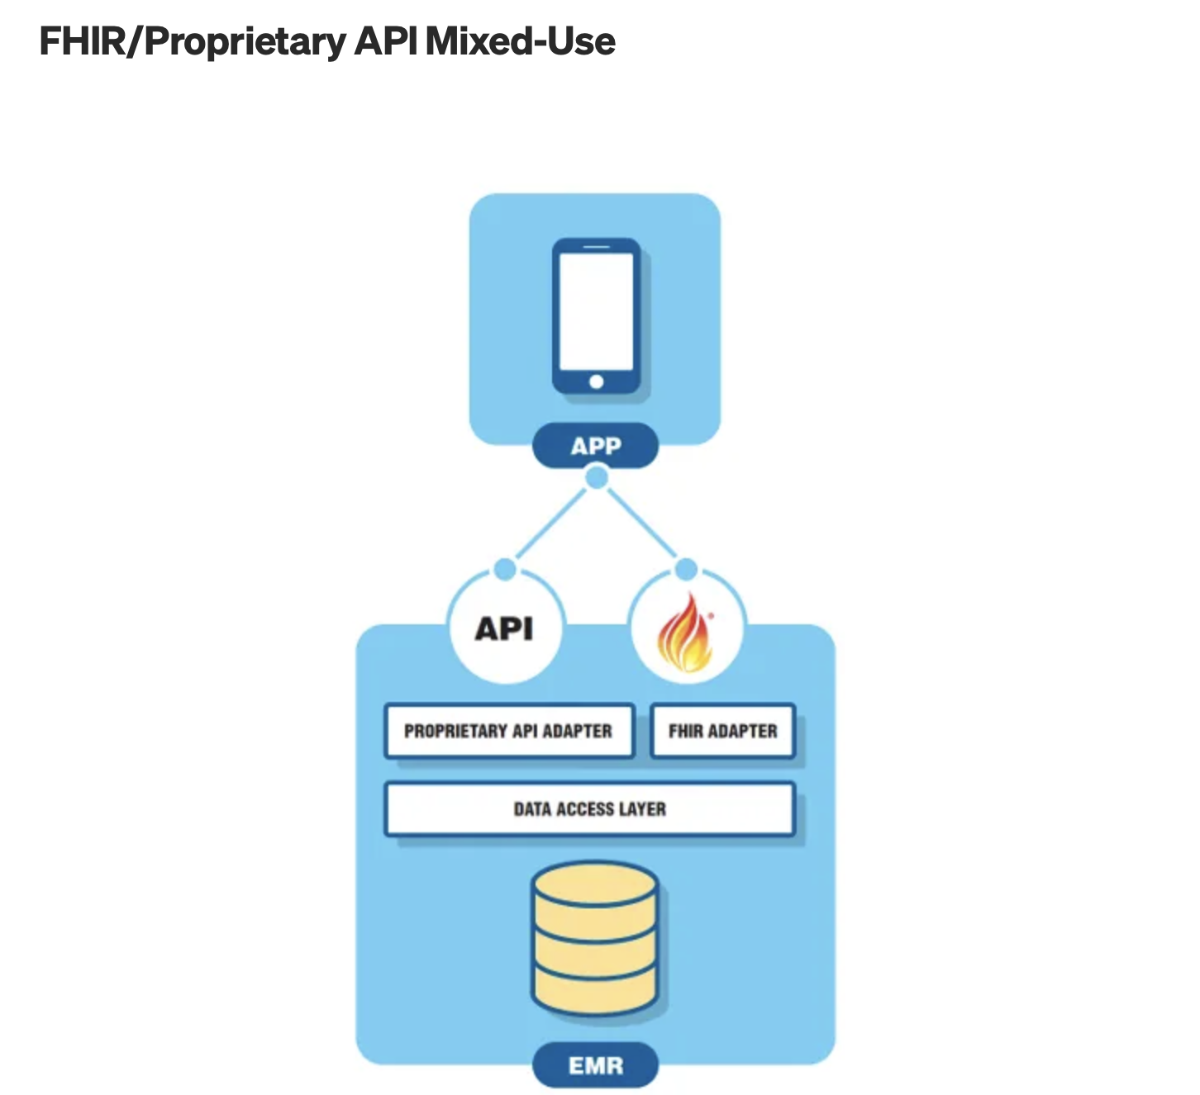

Slide 4
he FHIR server with which you intend to integrate doesn’t support the FHIR capabilities you need. A common case here is FHIR write support. Several large EMRs do not support FHIR writes, yet your application solution may have mandatory requirements to store all data in the EMR for compliance purposes. Should a hospital, for example, receive a request for all of a patient’s data, the release of the information department is only going to look for data in one location — the EMR. It is complex, cumbersome, and unrealistic to have that department probe numerous systems for data about a patient — especially when they might not even know about the existence of those other systems.
The FHIR specification may not describe your healthcare domain concept or use case. If you find this to be the case, consider participating in HL7 to advance the FHIR specification itself! You will find an interested community of other healthcare technologists that want to help advance the state of interoperability along with you.

Slide 5
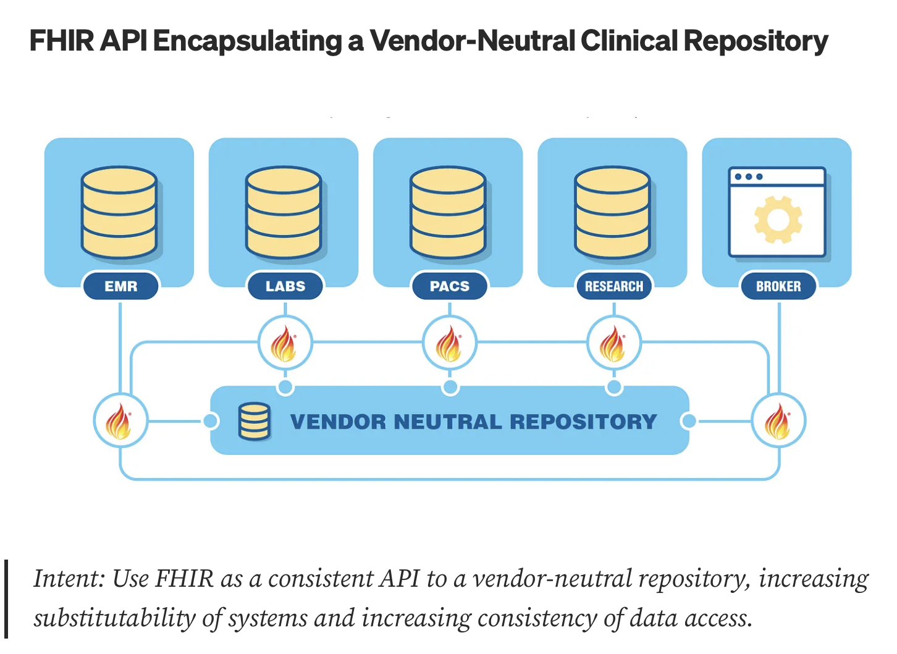

Slide 6
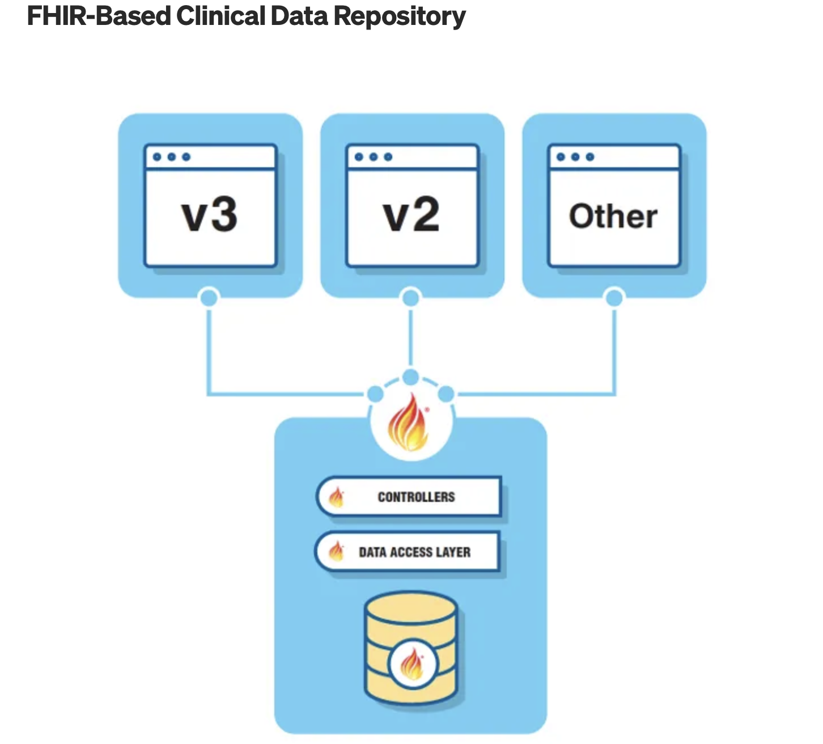
Intent: Instead of mapping a solution to fit FHIR, start with FHIR as a platform design specification, and create a FHIR-native solution from it directly.

Slide 7
Intent: Instead of mapping a solution to fit FHIR, start with FHIR as a platform design specification, and create a FHIR-native solution from it directly.

Slide 8
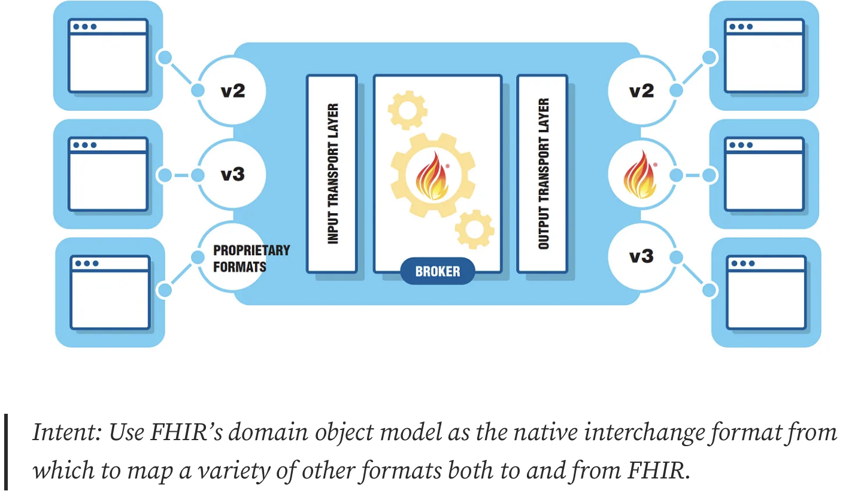
FHIR-Based Integration Hub

Slide 9
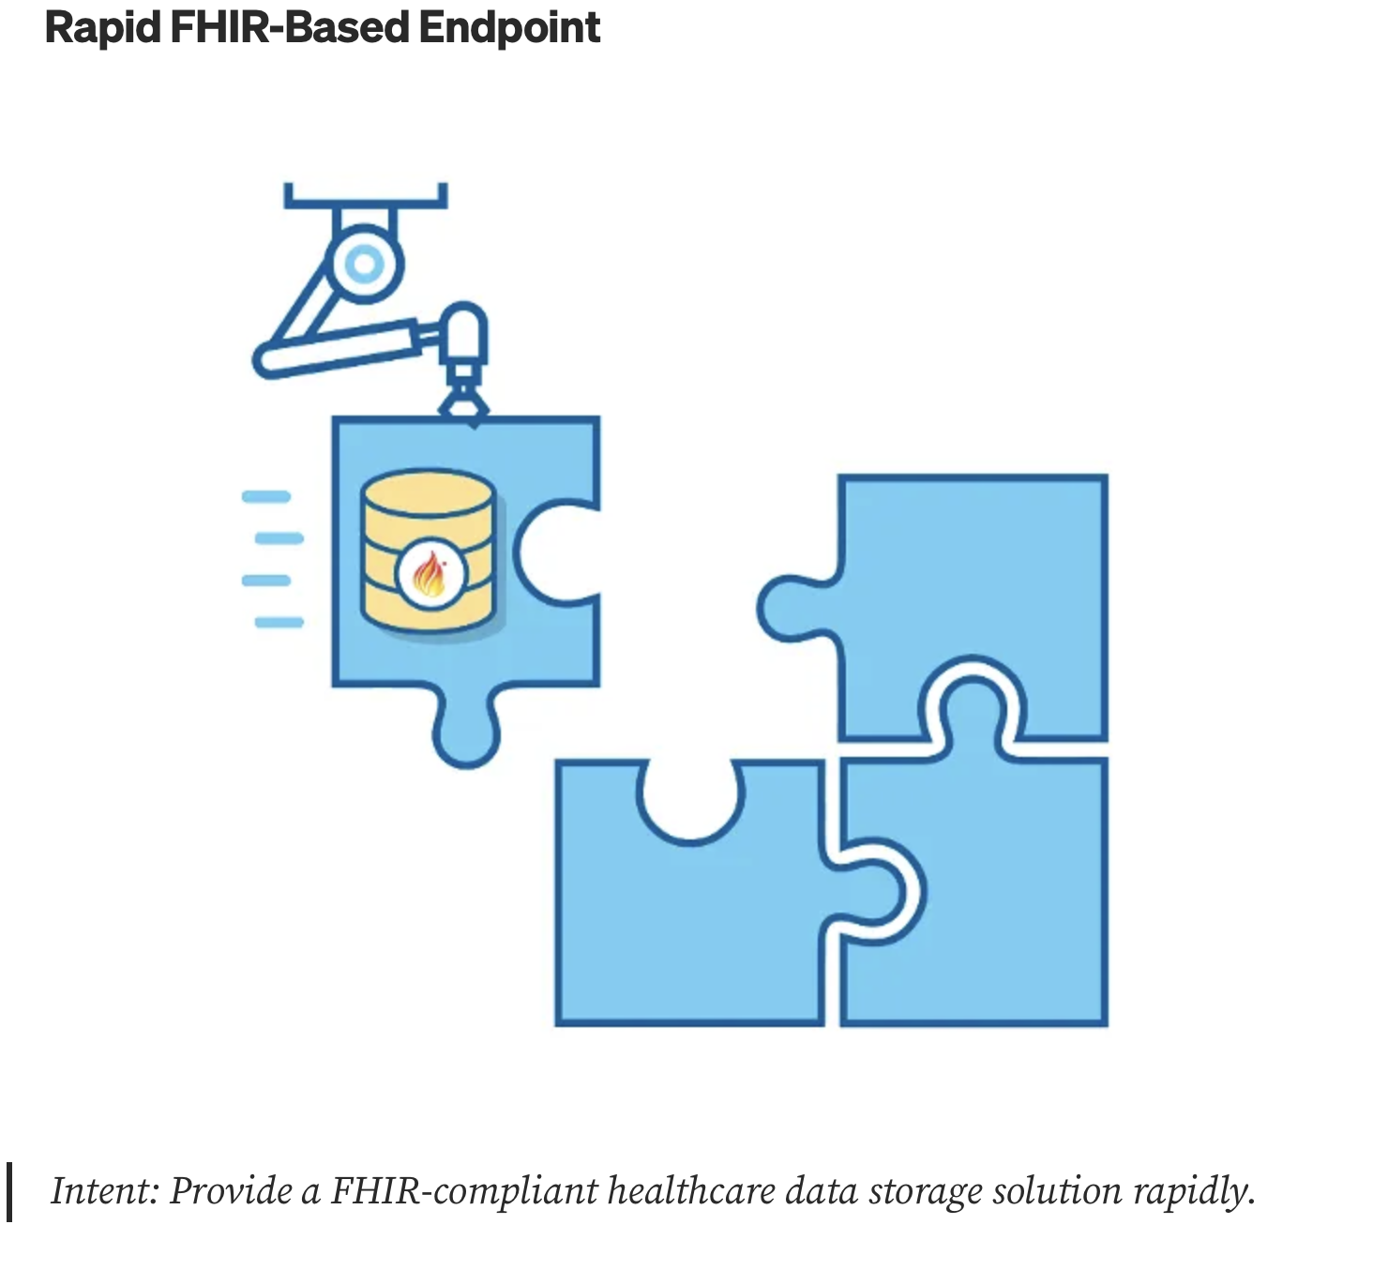

Slide 10
RNDS
RNDS

Slide 11
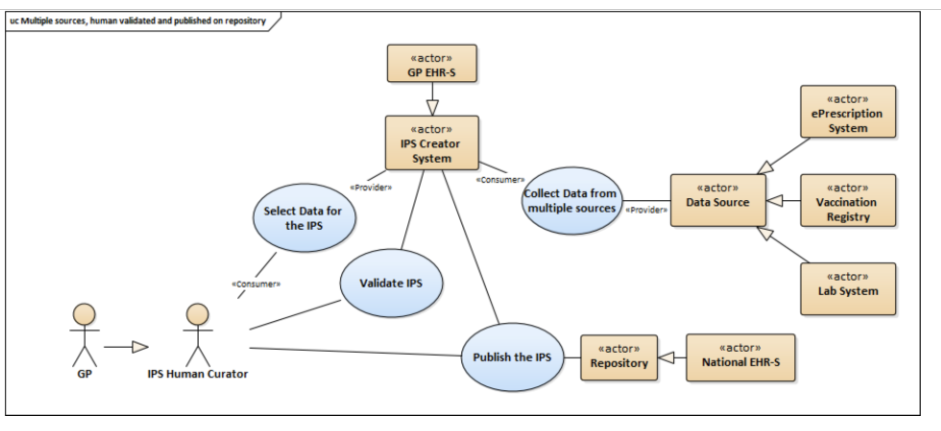

CNES
CADSUS
Gerador de IPS
Coletar dados da RNDS
Fontes de Dados
PNI
Selecionar Dados para o IPS
Validate (FHIR)
Exames Covid e MonkeyPox
Repositório IPS Brasil
Publicar/Armazenar
Notes:
Definir regras para extração dos dados da RNDS para poder automatizar o processo de curadoria do Sumário. Regras para Imunização e Exames.

Slide 12
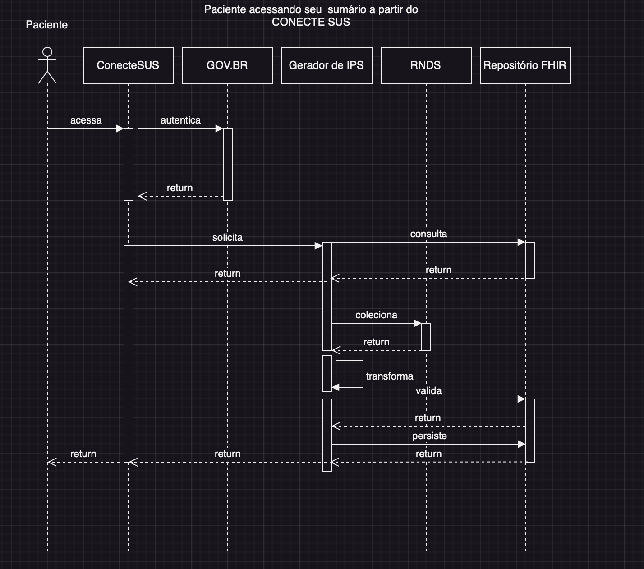

Slide 13
